Slide 1
How to use a normalization rule to combine data from two different holdings record fields into one bibliographic field via the publishing profile
Yoel Kortick
Senior Librarian

Slide 2
  Introduction
  The sample record
  The publishing profile
  The initial result of the publishing
  The normalization rule and process
  The new result publishing with the normalization process

Slide 3

Introduction

Slide 4
Introduction
In this presentation we will show how to combine two fields with the same tag into one field.
In the specific situation here a publishing profile has been defined to
  send data from the 852 of the holdings record to publish to the 949 of the bibliographic record
  send data from the 866 of the holdings record to publish to the 949 of the bibliographic record

Slide 5
Introduction
In the resulting published file two 949 fields are created:
  One 949 field contains data that was in the 852 of the holdings record
  One 949 field contains data that was in the 866 of the holdings record
The institution desires to have one 949 field with all the data in one field.

Slide 6


The sample record

Slide 7
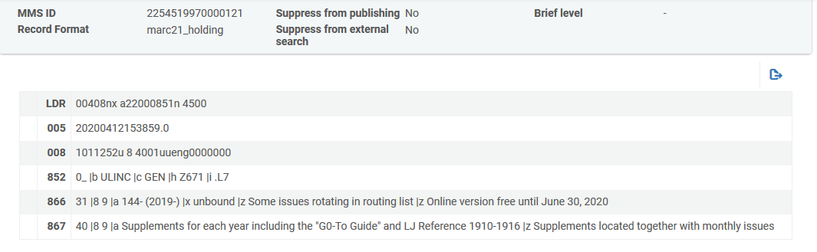
The sample record
This is a holdings record which will be published.
It has an 852 field and an 866 field.

Slide 8

The publishing profile

Slide 9
The publishing profile
In the “Data Enrichment” tab of the publishing profile we will define as follows:
  Send the 852 subfield b of the holdings record to the 949 subfield b of the bibliographic record
  Send the 852 subfield c of the holdings record to the 949 subfield c of the bibliographic record
  Send the 866 subfield a of the holdings record to the 949 subfield d of the bibliographic record

Slide 10
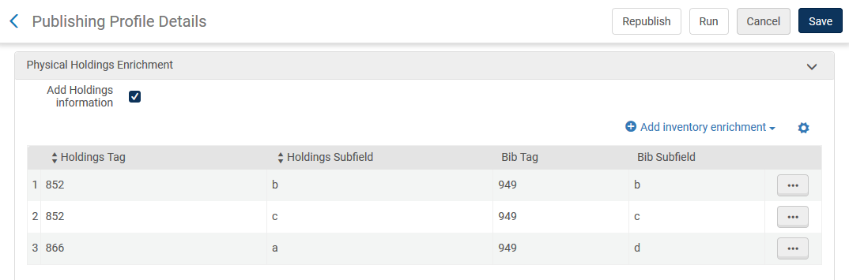
The publishing profile
The “Data Enrichment” tab of the publishing profile:

Slide 11

The initial result of the publishing

Slide 12
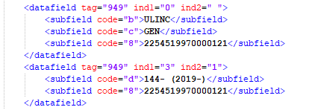
The initial result of the publishing
When the 852 and 866 from the holdings record is published to the 949 field of the bibliographic record there are two separate 949 fields
Came from 852 b
Came from 852 c
Came from 866 a

Slide 13

The normalization rule and process

Slide 14
The normalization rule and process
We will create a normalization rule as follows.
It combines both 949 fields except for subfield z (which in our case is irrelevant, but it is in the rule to show the syntax)
rule "combine 949 fields"
when
(TRUE)
then
combineFields "949" excluding "z"
end

Slide 15
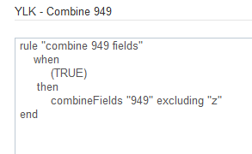
The normalization rule and process
Here is the rule in the metadata editor

Slide 16
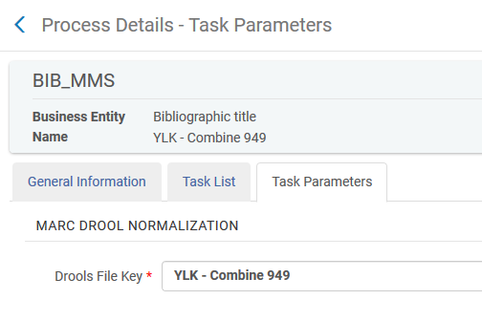
The normalization rule and process
Here is the normalization process using the normalization rule

Slide 17
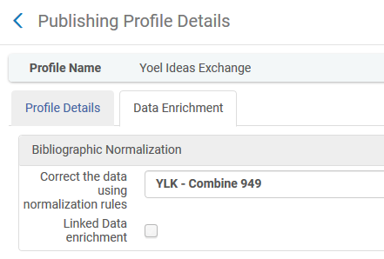
The normalization rule and process
Here is the normalization process in the publishing profile
We added the normalization process to the publishing profile in the “Data Enrichment” tab

Slide 18
The new result publishing with the normalization process

Slide 19
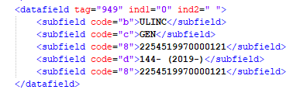
The new result publishing with the normalization process
Now after adding the normalization process to the publishing profile and publishing again we see that all fields are in one 949 field
Came from 852 b
Came from 852 c
Came from 866 a

Slide 20
xxx@exlibrisgroup.com

